Slide 1
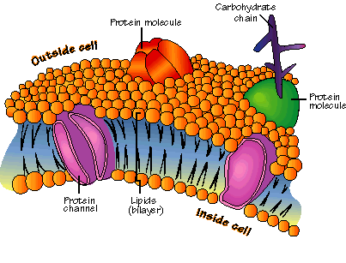
11ATAR Biology
Week 21 –
Exchange of Materials

Slide 2

Year 11 Biology Work Schedule
It is important to remain on schedule during this Semester.
Moodle
Have you visited Moodle this week? Yes / No
Tasks
Are you on schedule? Yes / No
When is your next task due?

Slide 3
Review from last term
What do you remember?
Review
Animal vs Plant cell
Organelles and their functions
Structure of cell membrane

Slide 4
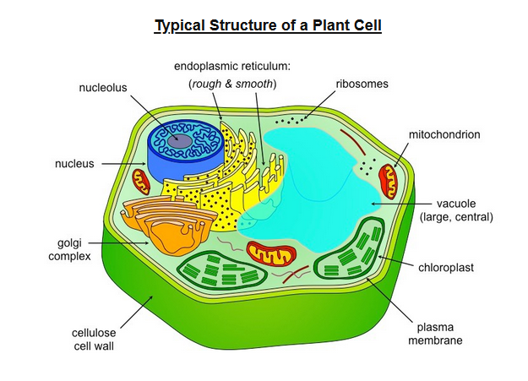
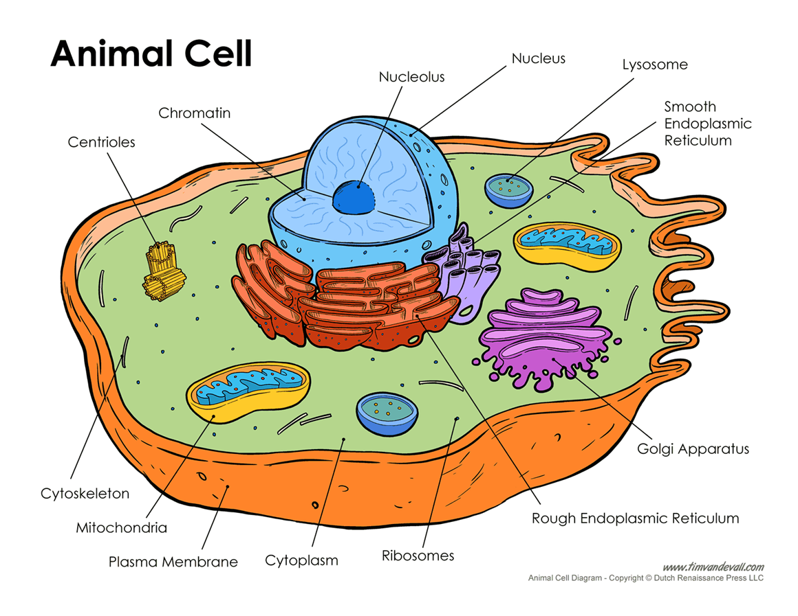
Plant and Animal cells

Slide 5
Plant and Animal Cell Differences
Plant cells have rigid cell walls.
Plant cells contain chloroplasts which contain chlorophyll, a green pigment needed for photosynthesis.
Plant cells contain a large vacuole; animal cells never contain large vacuoles.
Plant cells are regular in shape; animal cells are irregular in shape.
Animal cells often have cilia or flagella and lysosomes; plant cells do not.

Slide 6
Learning Intentions
• The currently accepted model of the cell membrane is the fluid mosaic model.
• The cell membrane separates the cell from its surroundings and controls the exchange of materials, including gases, nutrients and wastes, between the cell and its environment.
• Movement of materials across membranes occurs via
- passive processes, including diffusion, facilitated diffusion, osmosis
- active processes, including active transport, endocytosis and exocytosis
Success Criteria
Students will be able to:
Describe the structure and function of the cell membrane.
Distinguish between various methods of material transport across semipermeable membranes.

Slide 7
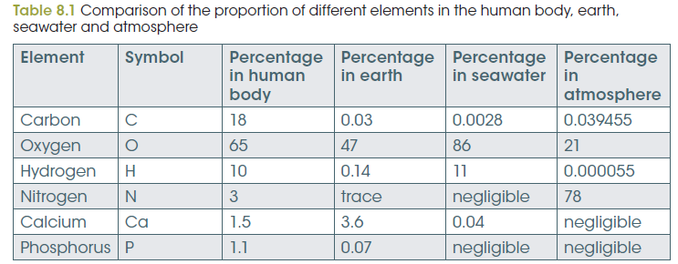
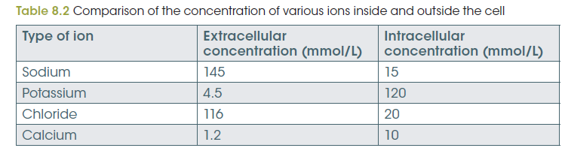
Internal Environment of Cells
Almost 99% of the mass of an average human body is made up of only six elements: oxygen, carbon, hydrogen, nitrogen, calcium and phosphorus.
The cells in multicellular organisms are more protected from the swings of environmental change because they are surrounded by extracellular fluid.
In humans, the contents of this liquid are kept fairly constant by the workings of various organs such as the lungs, kidneys and liver.

Slide 8
Internal Environment of Cells
The internal environment must be regulated and maintained because of:
Complex chemical reactions including respiration and photosynthesis.
Enzymes can only perform their tasks within narrow temperature and pH ranges.
Hydrogen ion concentrations kept within strict limits to maintain suitable cytoplasmic pH.
Toxic waste products are removed to ensure they do not interfere with chemical reactions in the cytoplasm.

Slide 9
Plasma membrane
Cells need an inside & an outside.
The plasma membrane separates the cell from its environment and creates its boundary.
The plasma membrane allows substances in and out of the cell.
IN:
food
- sugars
- proteins
- fats
- salts
- O₂
- H₂O
OUT:
waste
- ammonia
- salts
- CO₂
- H₂O
products
- proteins
cell needs materials in & products or waste out

Slide 10
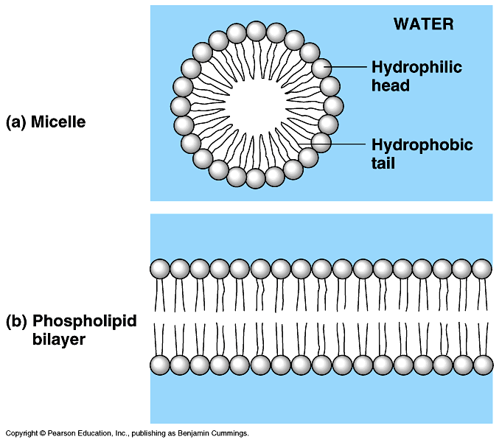
Lipids of the plasma membrane
Membrane is made of special kind of lipid called phospholipids.
Membrane is a double layer – hence the name phospholipid bilayer
“attracted to water”
phosphate
inside cell
lipid
outside cell
“repelled by water”

Slide 11
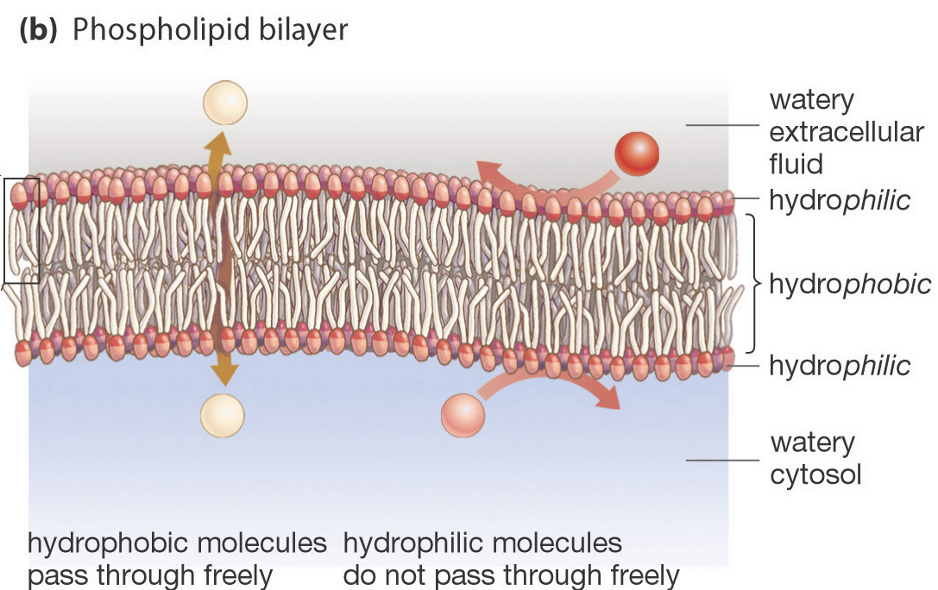
Plasma membrane
Recall form last term that:
Phosphate (polar) heads are hydrophilic “water loving” lipid (nonpolar), tails are hydrophobic “water fearing”.
Whether substances will move through the membrane freely or not depends on whether they are hydrophobic or hydrophilic.

Slide 12
Semi-permeable membrane
Plasma membrane controls what gets in or out
The cell needs to allow some materials — but not all — to pass through the membrane. This is why it is semi-permeable. Only some material can get in or out.
Fats and oils can pass directly through the plasma membrane. This is because they are hydrophobic (water-fearing).
Other substances use other pathways.
So what needs to get across the membrane?
sugar
lipids
amino
acids
O₂₂
H₂O
salt
waste

Slide 13
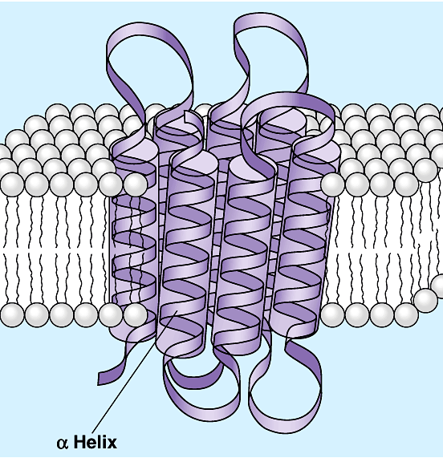
Proteins of the Plasma membrane
Other substances need to make “doors” through the membrane.
Channels proteins, carrier proteins and ion pumps allow substances in & out. These are specific to the molecule they can transport e.g. H2O channel, salt channel, sugar channel, etc.
inside cell
H₂O
aa
sugar
salt
outside cell
waste

Slide 14
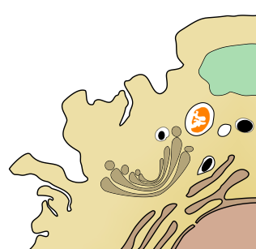
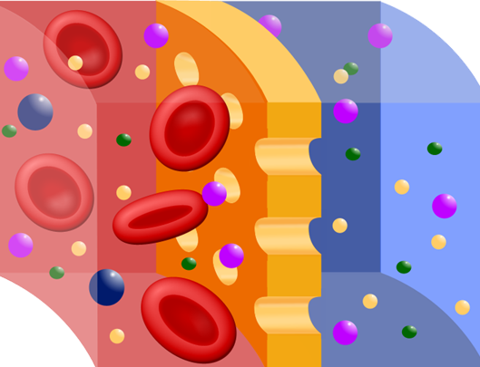
Cell Transport
Substances need to move into and out of the cell. They are moved across the plasma membrane by cellular transport mechanisms. These may be:
  passive transport (not requiring energy)
    diffusion and facilitated diffusion
    osmosis
  active transport (energy requiring)
    ion pumps
    cytosis (endocytosis / exocytosis)
The plasma membrane is partially
permeable to certain molecules.
  Channel and carrier proteins are
  involved in selective transport of small
  molecules and ions across the membrane.
  Large molecules (e.g. proteins) are
  transported by cytosis (formation of
  membrane-bound vesicles or vacuoles).
Plasma membrane
Cell cytoplasm
The plasma membrane is partially permeable, allowing some molecules to pass through, and preventing the passage of others.

Slide 15

Diffusion
Diffusion is a passive transport process. It does not require energy to occur.
Diffusion is the movement of molecules from a region of high concentration to a region of low concentration along a concentration gradient.
In biological systems, diffusion often occurs across partially permeable membranes.
High concentration
Low concentration

Slide 16
Diffusion
Can you think of an example of diffusion happening in your real life?
Notes:
E.g. Sugar/coffee powder/tea diffusing through hot water.

Slide 17
Diffusion Across Membranes
In any type of diffusion, each type of diffusing molecule (gas, solvent, solute) moves along its own concentration gradient.
An equilibrium is reached when the net concentration of molecules on each side of the membrane are equal.
  At this point, net movement stops.
Two-way diffusion across a partially permeable membrane is common in biological systems.
  For example, at the lung surface, carbon dioxide diffuses out of the blood across the membranes of the capillaries and the lung alveoli, while oxygen diffuses in the opposite direction into the blood.
Partially permeable membrane

Slide 18
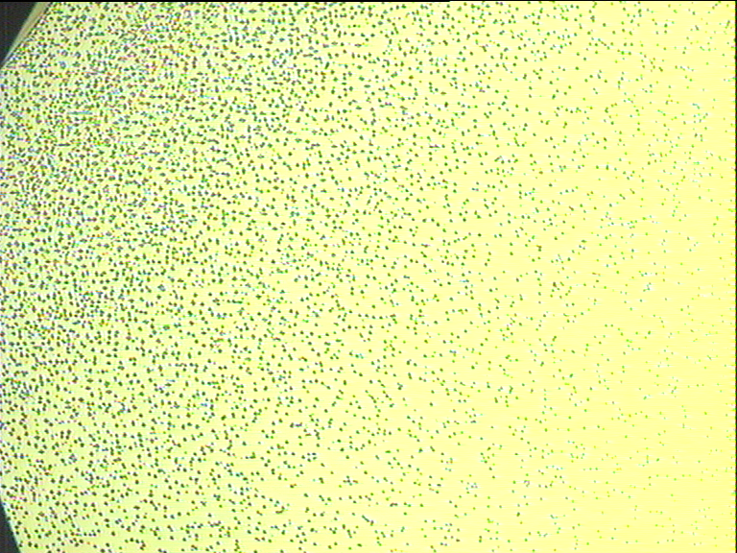
Concentration gradient
When the concentration of a substance is different at two places, the substance will diffuse along the concentration gradient until the concentration of the two areas becomes equal.
High concentration
Diffusion gradient
Low concentration

Slide 19
Concentration at A
Concentration at B
1
Steep diffusion gradient = higher rate of diffusion
High concentration
Low concentration
2
Rate of diffusion slows
Equilibrium
3
Uniform concentration

Slide 20
Simple Diffusion
- The movement of molecules along a concentration gradient without the assistance of membrane proteins.
fat
Which way will the fat molecules move?
fat
inside cell
fat
fat
LOW
HIGH
fat
outside cell
fat
fat
fat
fat
fat
fat
fat

Slide 21
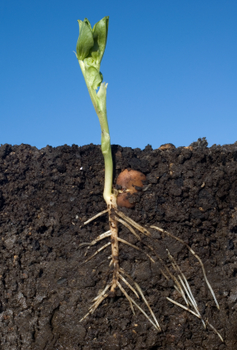
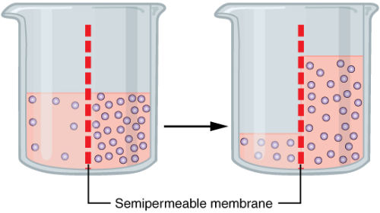
Osmosis
Osmosis is defined as the net movement of water molecules across a partially permeable membrane from a region of higher to lower concentration (of water molecules).
It is essentially the diffusion of water.
Osmosis provides the primary means by which water is transported into and out of cells.
Osmosis is affected by the same factors
as diffusion.
Solute molecule
A plant’s root system covers a large area, allowing it to draw water and nutrients up from the soil. Water is drawn into the root system by osmosis.
water

Slide 22
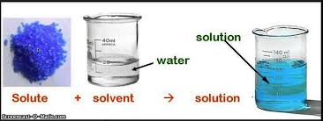
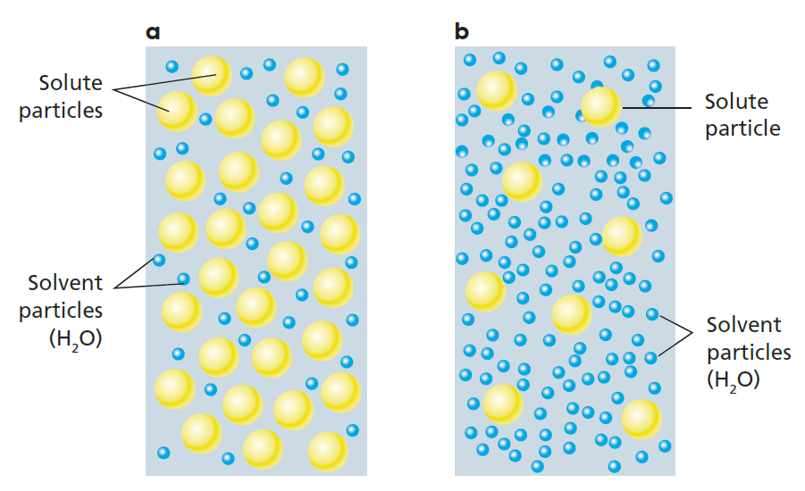
Osmosis
Water in organisms is part of a solution. A solution consists of a solute and a solvent. Water is always the solvent (the one that does the dissolving) and solutes are the compounds dissolved in the solvent, like sugar and salt.
A dilute solution means it has a high water concentration compared to the solute. A concentrated solution means it has a low water concentration compared to the solute.
Movement of water is affected by the solution concentration of cellular fluids.

Slide 23
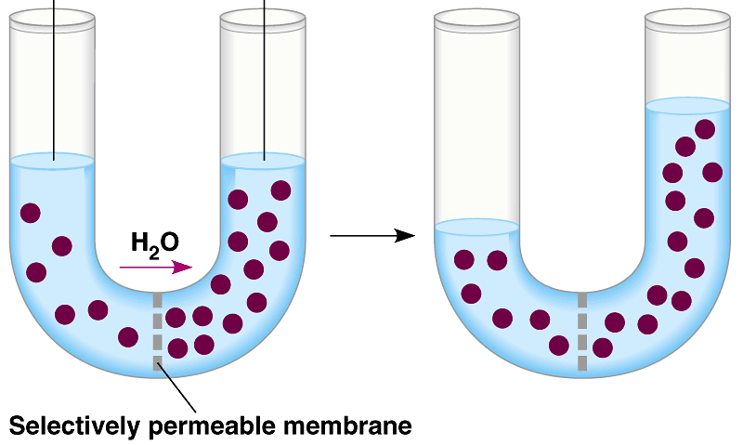
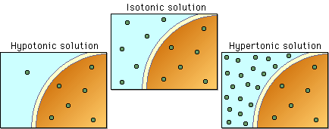
Osmosis
If solution concentrations are equal inside and outside a cell, it is said to be isotonic. In this case, water will move equally in both directions and be at equilibrium.
When cells are surrounded by a dilute solution (low solute/high water concentration), the external solution is said to be hypotonic compared to the inside of the cell. In this case, water will move into the cell because the cell cytoplasm has a higher solute concentration (hence it also has a lower water concentration).
When cells are surrounded by a concentrated solution (high solute/low water concentration), the external solution is said to be hypertonic compared to the inside of the cell. In this case, water will move out of the cell because the cell cytoplasm has a lower solute concentration (a higher water concentration).

Slide 24
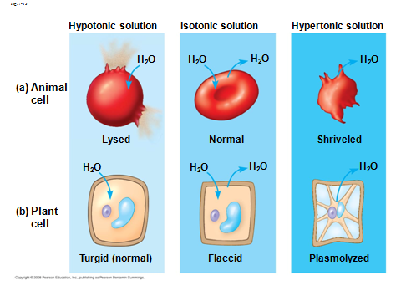
Keeping the Water Balance
Cell survival depends on balancing water uptake & water loss

Slide 25
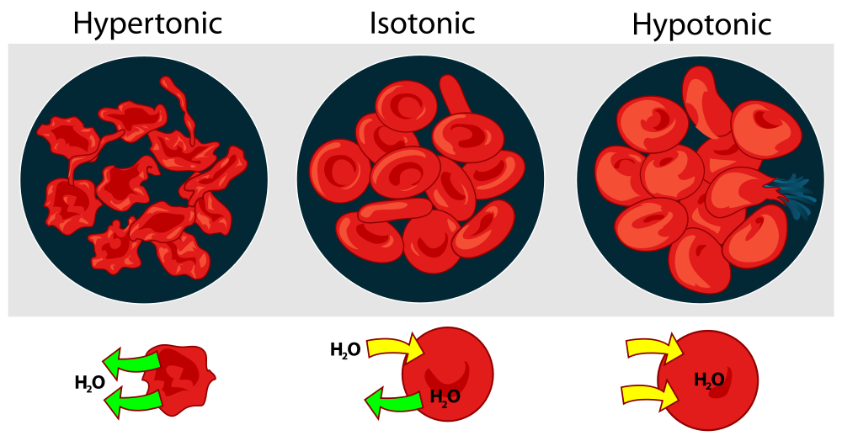
Osmosis in animal cells
A cell wall (in plants) provides protection to cells from too much water uptake. Animal cells do not have a cell wall and will burst (cell lysis) if too much water is taken into the cell.
Animals overcome this in a number of ways. Many unicellular animals are able to store water in contractile vacuoles. Which expel water from the cell when filled.
Multicellular animals have extracellular fluid which is maintained at an isotonic level. The kidneys constantly filter and adjust solution concentration levels of the blood to maintain the isotonic environment.

Slide 26
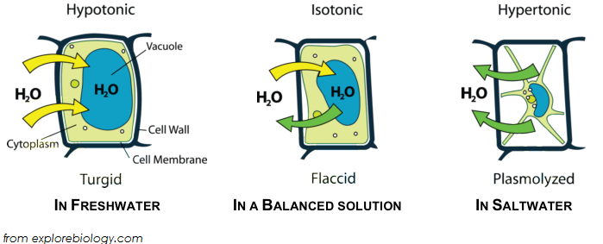
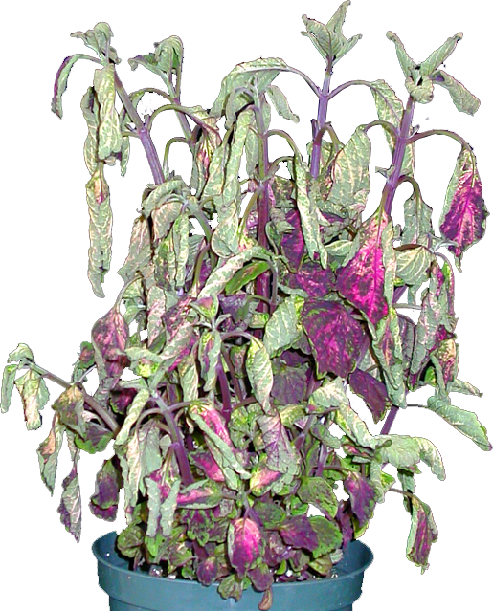
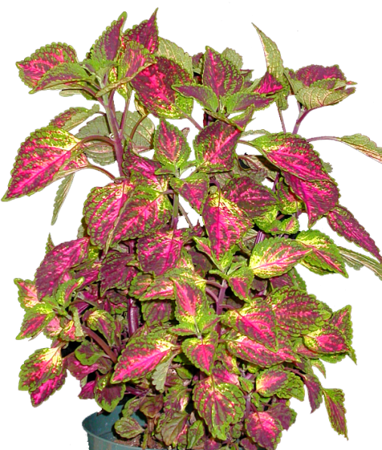
Osmosis in plants
If a plant cell is placed in a hypotonic solution, water enters the cell causing it to swell. The rigid cell wall prevents cell rupture. Cells in this state are termed turgid.
If a plant cell is placed in a hypertonic solution, the plant cell loses water to the environment. This state is called plasmolysis.
Full plasmolysis is irreversible, the cell cannot recover by taking up water.
Healthy turgor in Coleus
Wilting in Coleus induced by water loss from the cells.

Slide 27
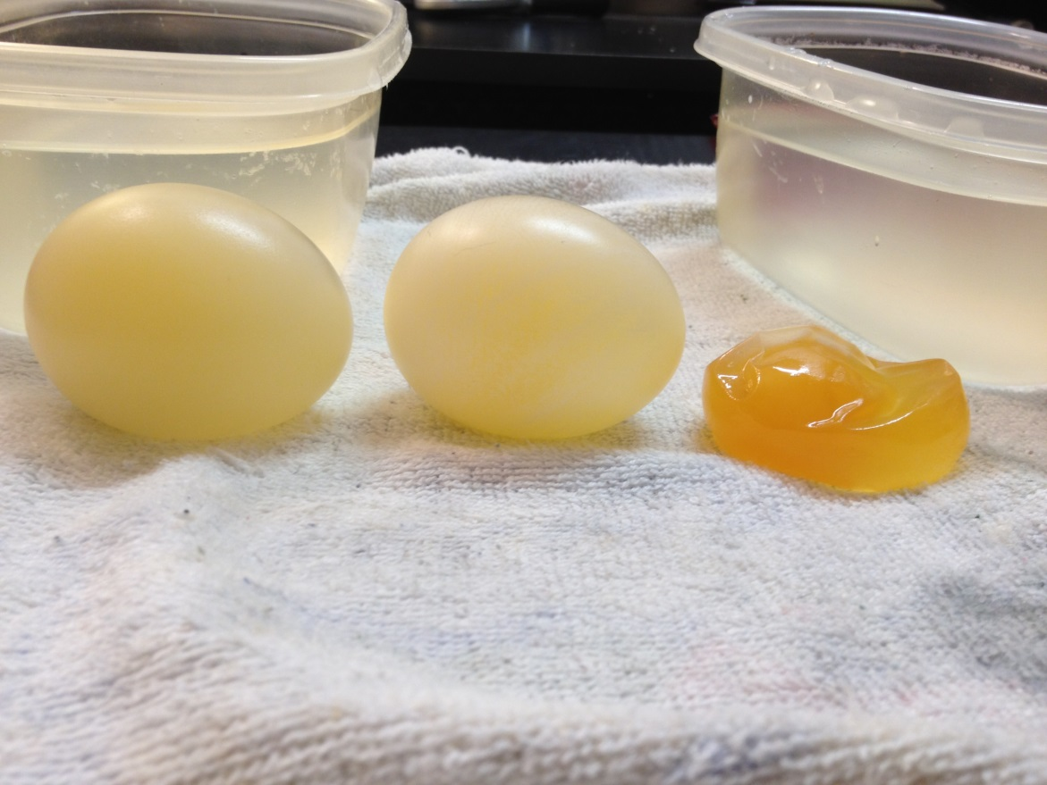
Osmosis
Observing osmosis in action, check out this video of experiments with eggs.
https://www.youtube.com/watch?v=SSS3EtKAzYc

Slide 28
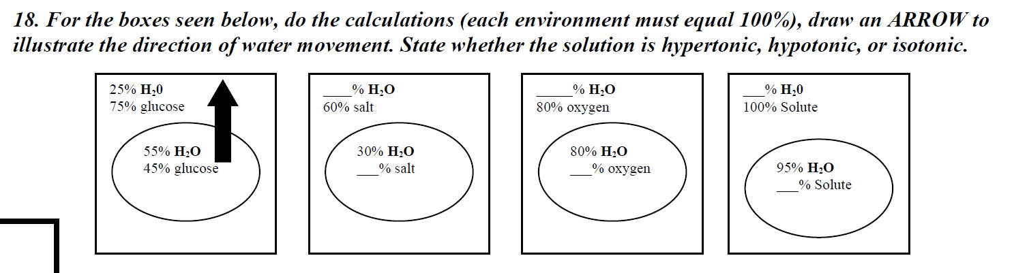
Osmosis question
Notes:
Hypertonic – water goes out
Hypotonic – water goes in
Hypertonic – water goes out
Hypertonic – water goes out

Slide 29
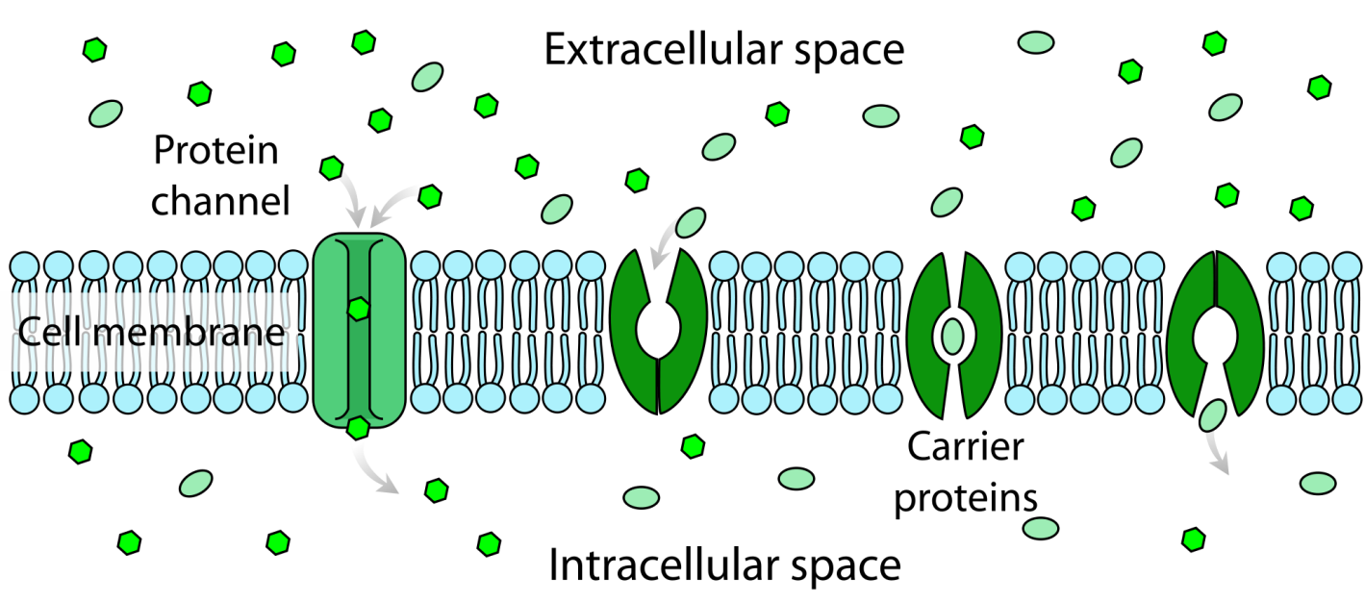
Facilitated Diffusion
Facilitated diffusion occurs when a substance is aided across a membrane by channel proteins or carrier proteins.
Facilitated diffusion selectively increases the diffusion rate of specific molecules (e.g. glucose, amino acids).
It does not require energy because the molecules are not moving against their concentration gradient.
It occurs when a higher diffusion rate is desirable, e.g. transport of glucose into skeletal muscle fibers.

Slide 30
Simple vs. facilitated diffusion
simple diffusion
facilitated diffusion
lipid
inside cell
inside cell
H₂O
protein channel
H₂O
outside cell
outside cell

Slide 31
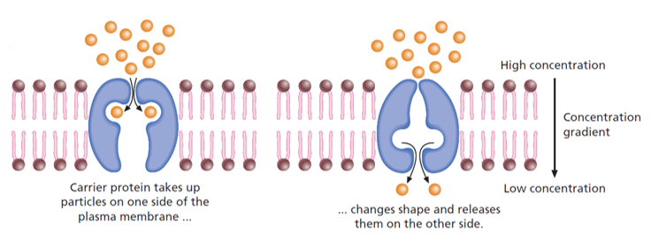
Facilitated diffusion – carrier protein
Carrier proteins bind to specific molecules on one side of the membrane, change shape and release the substance on the other side.
Glucose moves in this way.
Remember – this still does not require energy.

Slide 32
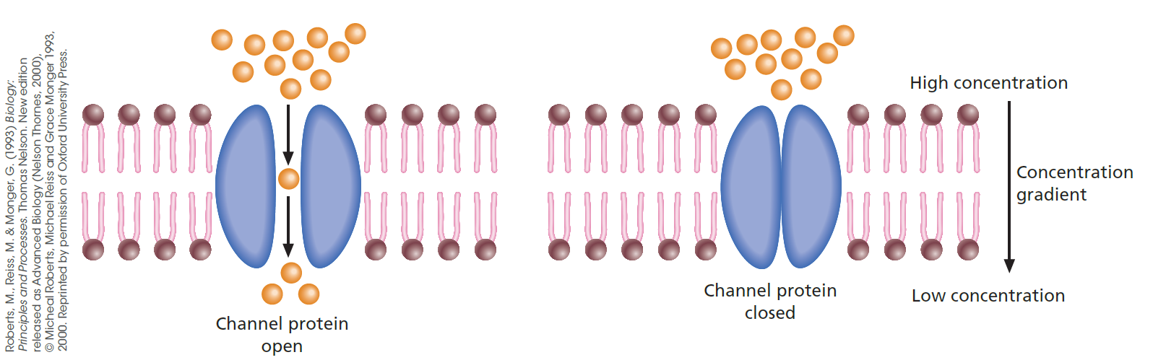
Facilitated diffusion – channel protein
Channel proteins form narrow passageways through which small ions can diffuse rapidly from a high ion concentration to a lower ion concentration.
Only ions of a specific size and shape can pass through a particular channel protein.
Remember – this still does not require energy.

Slide 33
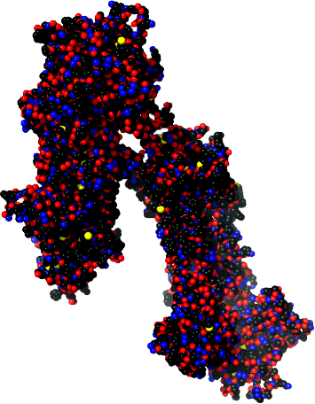
Active Transport
Active transport processes require energy expenditure because materials must be moved against their concentration gradient.
Active transport is performed by specific carrier proteins in the membrane. These are often referred to as ion pumps.
Transport proteins harness the energy of ATP to pump molecules from a low concentration to a high concentration (the reverse of diffusion).
  When ATP transfers a phosphate group to the carrier protein, the protein changes its shape so that the bound molecule can move across the membrane.
Space filling model of rabbit
calcium ATPase. Calcium ATPase is a membrane transport protein which transfers calcium after a muscle has contracted.

Slide 34
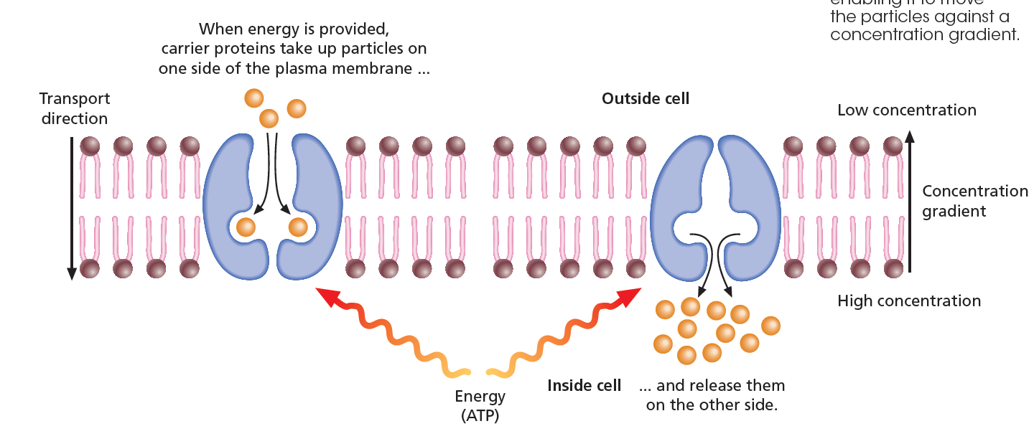
Active Transport
Membrane transport proteins, similar to those responsible for facilitated diffusion, use energy from adenosine triphosphate (ATP) to move molecules or ions against the concentration gradient.
As these carrier proteins work in only one direction, they effectively act as one-way valves.

Slide 35
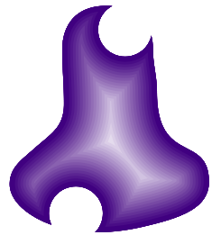



Sodium-Potassium Pumps
Extracellular fluid
Na⁺
Na⁺
K⁺
The sodium-potassium pump is a protein in the membrane that exchanges sodium ions (Na+) for potassium ions (K+) across the membrane.
ATP is used as the energy source for the exchange.
The unequal balance of
Na+ and K+ across the membrane creates large gradients in ion concentration, which can be used to drive other active transport mechanisms.
Na⁺
Plasma membrane
Carrier protein
K⁺
ATP
Na⁺
Na⁺ moves to its binding site
K⁺
Cell cytoplasm

Slide 36
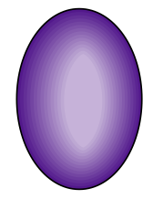
Proton
Pumps
Extracellular fluid
H⁺
H⁺
Proton pumps use the energy from ATP to move hydrogen ions (H+) from inside the cell to the outside.
This creates a large difference in the proton concentration either side of the membrane, leaving the inside of the plasma membrane negatively charged.
The potential difference created can be coupled to transport other molecules across the membrane.
H⁺
H⁺
H⁺
H⁺
Carrier protein
Plasma membrane
ATP
H⁺
Cell cytoplasm

Slide 37
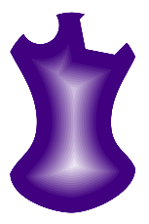
Co-Transport
Extracellular fluid
Diffusion of hydrogen ions down their concentration gradient
Co-transport is when substances couple together to move across the ion pumps.
Plant cells use the hydrogen gradient created by proton pumps to actively transport nutrients into the cell.
For example, the return of
H+ is coupled to the transport of sucrose into the phloem cells. The sucrose rides with the H+ as it diffuses down the concentration gradient maintained by the proton pump.
H⁺
H⁺
H⁺
Sucrose
Carrier protein
H⁺
Plasma membrane
H⁺
Cell cytoplasm

Slide 38
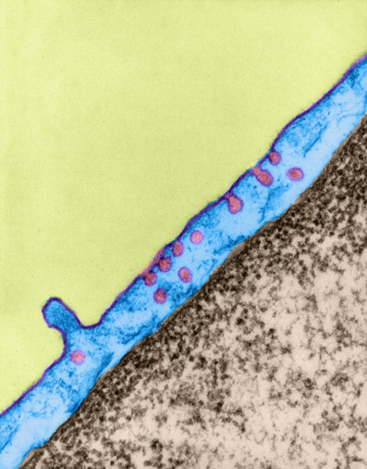
Cytosis
Membrane-bound vesicle
Cytosis is a form of active transport (requires energy) involving the formation of membrane-bound vesicles or vacuoles.
Regions of the plasma membrane become infolded or outfolded to transport substances across the membrane.
Cells are able to do this because of the mobile nature of the membrane.
Most cells carry out various forms of cytosis, including:
  endocytosis
  exocytotosis
Plasma membrane folding inwards
This cell is carrying out a form of endocytosis called pinocytosis in which the plasma membrane forms invaginations to enclose liquids and bring them into the cell.

Slide 39
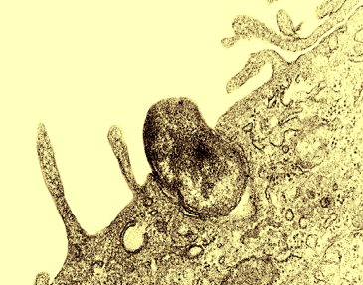
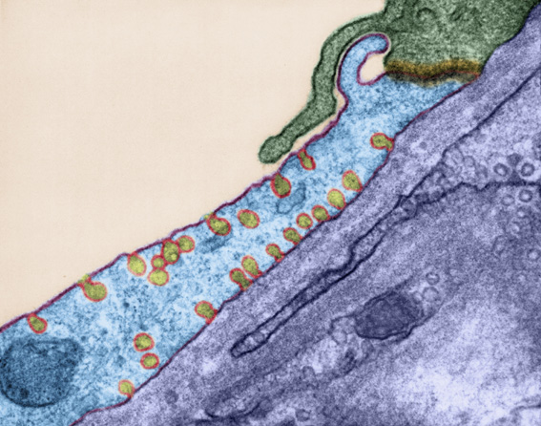
Endocytosis
Phagocytosis
Endocytosis describes the incorporation of substances from outside the cell into the cell as a membrane-bound vesicle or vacuole.
During endocytosis the plasma membrane folds in around the molecules to be transported into the cell.
There are several forms of endocytosis:
  phagocytosis: the engulfment
  of solid particles.
  pinocytosis: the engulfment
  of liquid particles.
Solid particle
CDC
Pinocytosis
Membrane-bound vesicle

Slide 40
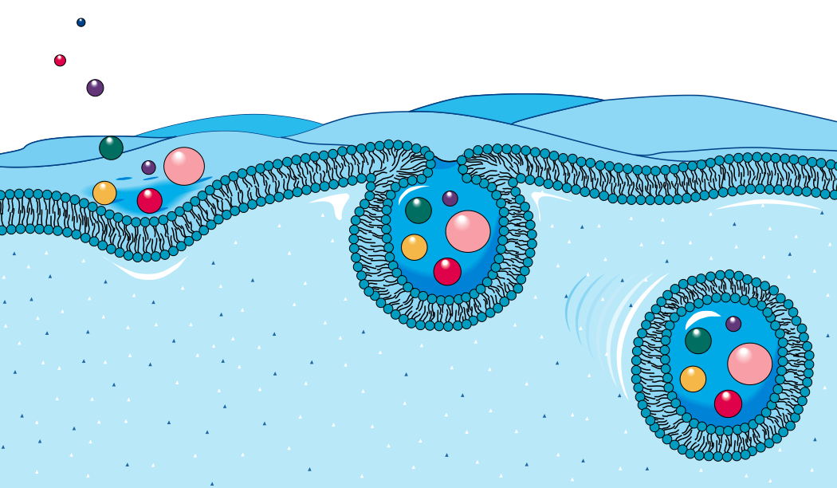
Endocytosis
1
Materials that are to be collected and brought into the cell are engulfed by an of the plasma membrane.
Plasma membrane
2
Vesicle buds off from the plasma membrane.
3
The vesicle carries molecules into the cell. The contents may then be digested by enzymes delivered to the vacuole by lysosomes.
Cell cytoplasm

Slide 41
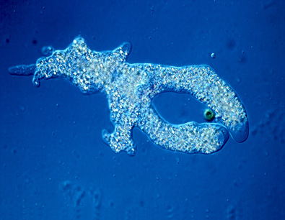
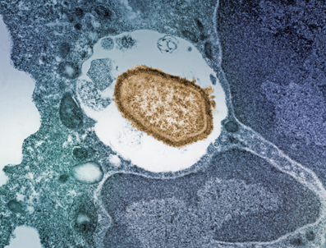
Phagocytosis
Phagocytosis (literally cell eating) describes the engulfment and transport of solid particles into the cell.
  The particles are contained within a membrane enclosed sac (a vacuole).
  Digestion of the particles occur when the vacuole fuses with a lysosome containing digestive enzymes.
Amoebae use phagocytosis to capture and ingest their food.
In humans, white blood cells, such as neutrophils and macrophages, use phagocytosis to clean up cell debris and foreign material such as bacteria.
Food particle
Amoeba pseudopod
Engulfed bacterium

Slide 42
Pinocytosis
Pinocytosis describes the engulfment of liquids or fine liquid suspensions into the cell.
  The plasma membrane enclose the liquid droplets within small vesicles.
  The fluid within the vesicle is transferred to the cytosol.
Pinocytosis is a non-specific form of endocytosis.
  Whatever solutes are suspended within the watery medium are also taken into the cell.
Plasma membrane engulfing liquid substance.
Membrane-bound vesicle
Pinocytosis by a capillary endothelial cell. TEM (X12,880)

Slide 43
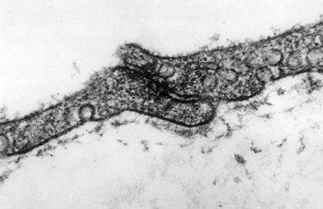
Exocytosis
Exocytosis releases substances from the inside of the cell to outside of the cell.
Exocytosis occurs by fusion of a vesicle membrane with the plasma membrane. The vesicle contents are then released to the outside of the cell.
In multicellular organisms, various types of cells are specialized to manufacture and export products from the cell to elsewhere in the body or outside it.
Transport vesicle
Cross section through the plasma membrane of cardiac muscle showing the presence of transport vesicles. TEM X 162,000

Slide 44
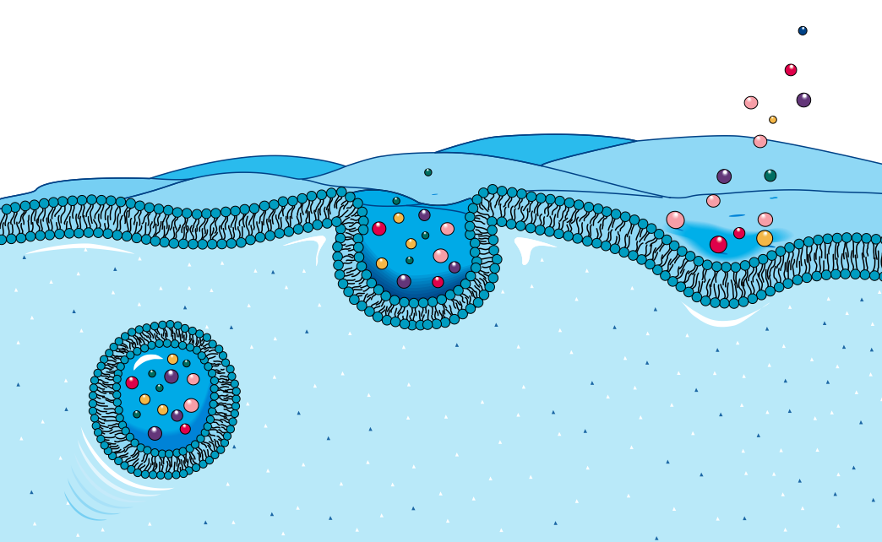
Exocytosis
3
The contents of the vesicle are expelled into the intercellular space (which may be into the bloodstream).
2
Vesicle fuses with the plasma membrane.
1
Vesicle carrying molecules for export moves to the perimeter of the cell.

Slide 45
Transport videos
Diffusion video - http://www.you2repeat.com/watch/?v=VY0mZUDvbH4
Facilitated diffusion - https://www.youtube.com/watch?v=vKGN_Zhz8AY
Osmosis video - http://highered.mheducation.com/sites/0072495855/student_view0/chapter2/animation__how_osmosis_works.html
Active transport video - https://www.youtube.com/watch?v=JGF6ry0SWPs
Endo and exocytosis video - http://highered.mheducation.com/sites/007337797x/student_view0/chapter5/animation_quiz_-_endocytosis_and_exocytosis.html

Slide 46
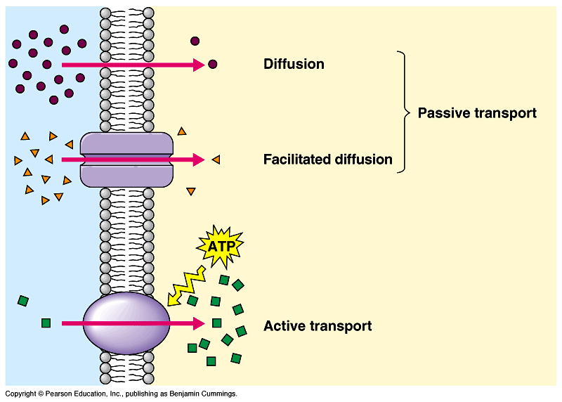
Transport summary
simple
diffusion
facilitated
diffusion
ATP
active
transport

Slide 47

Success Criteria
Describe the structure and function of the cell membrane.
Distinguish between various methods of material transport across semi-permeable membranes.

Slide 48
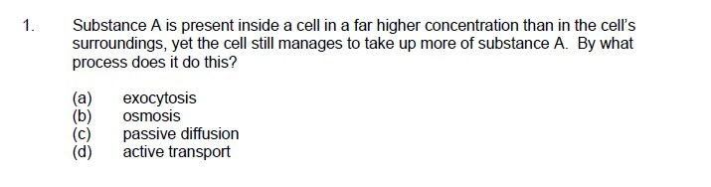
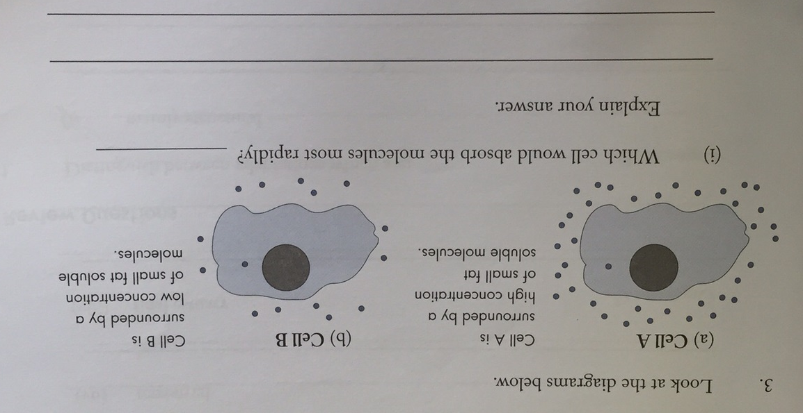
Exam review question
Notes:
1. (d) 3. Cell A as diffusion will follow the concentration gradient of the small fat-soluble molecules.

Slide 49

Moodle & Textbook Work
Chapter 9 pages 275-295 – check Moodle for questions sets.
Moodle workbook.
WACE study guide – Chapter 4.2 pages 99 -102.
MARK YOUR WORK!

Slide 50
Student Feedback
What I learnt today…..
What I need to revise….

